Slide 1
Transparent, flexible sheet
Wave-driven water flow
Solid cylinder
Light & temp. probes
O₂ probe
Water
tight seal
Weight
5cm into sand

Slide 2
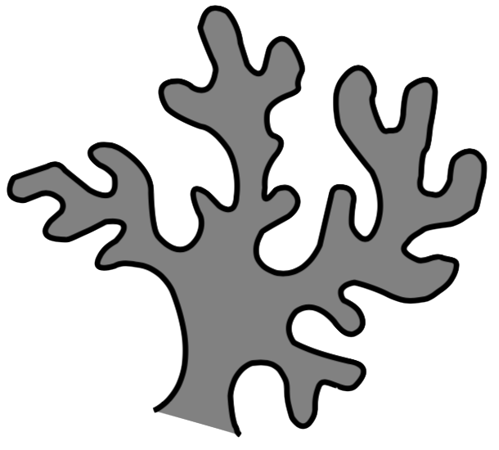
Light & temp. probes
Water
tight seal
Solid cylinder
O₂ probe
5cm into sand
Weight
Transparent, flexible sheet

Slide 3
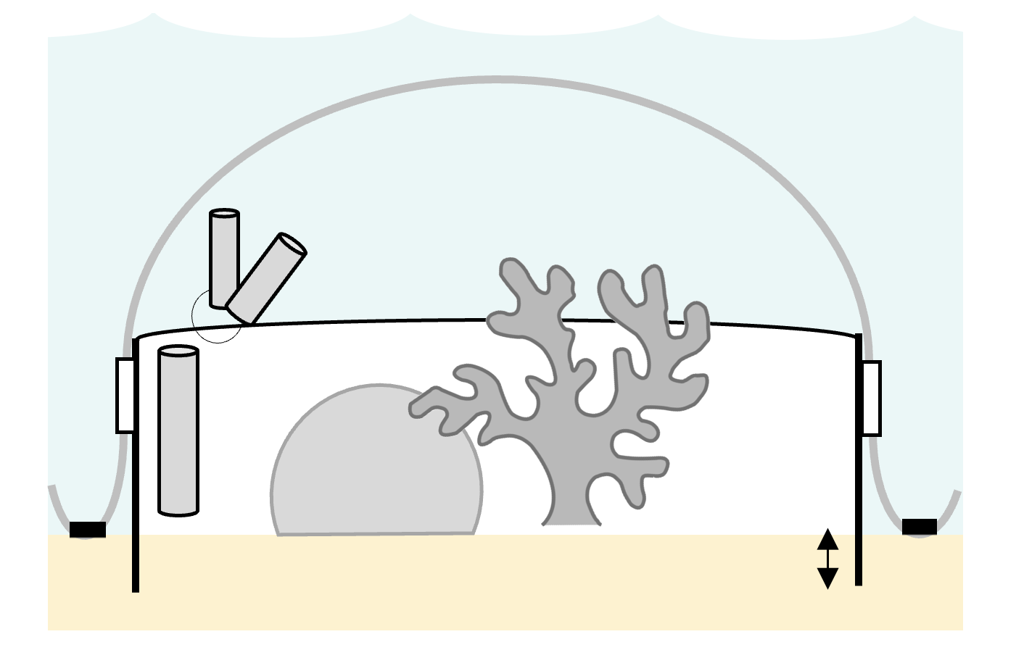
Transparent, flexible sheet
Temp & light probe
Solid cylinder
Ratchet strap
O₂ probe
Weight
5cm

Slide 4
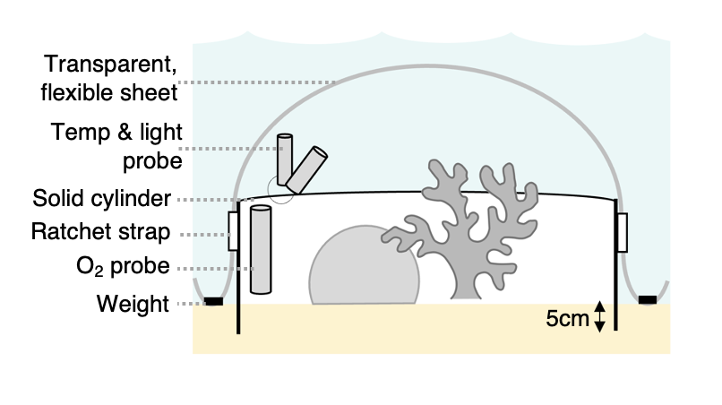
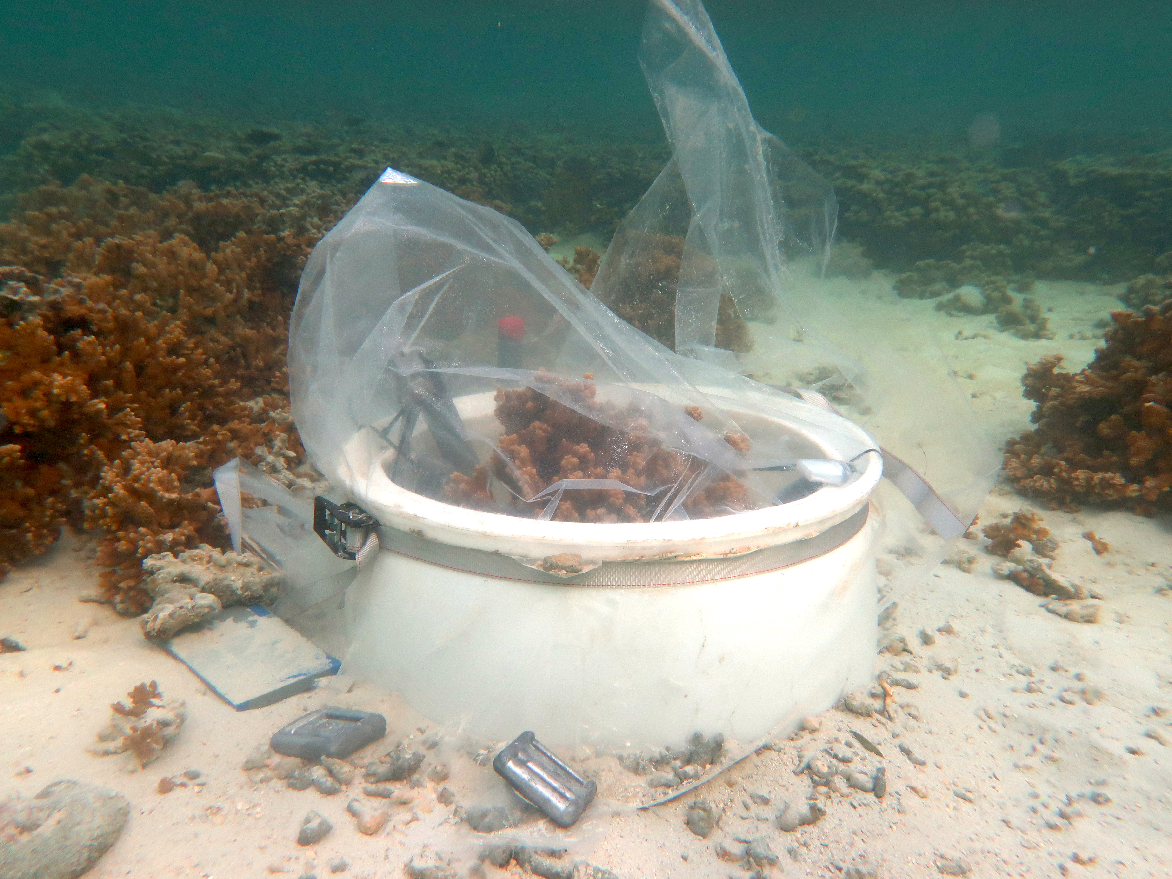
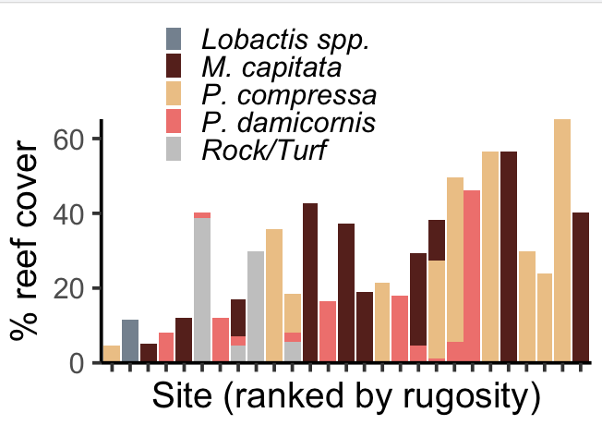
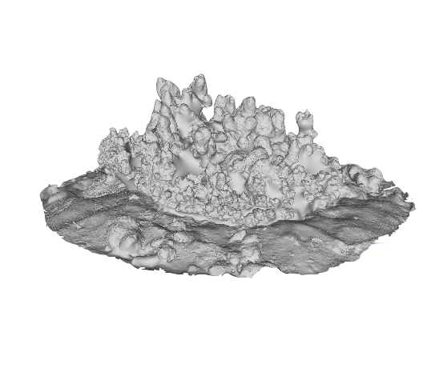
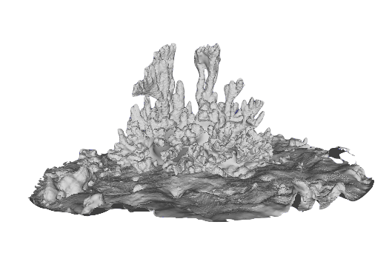
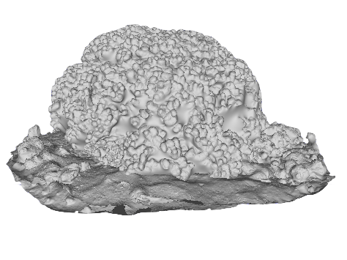
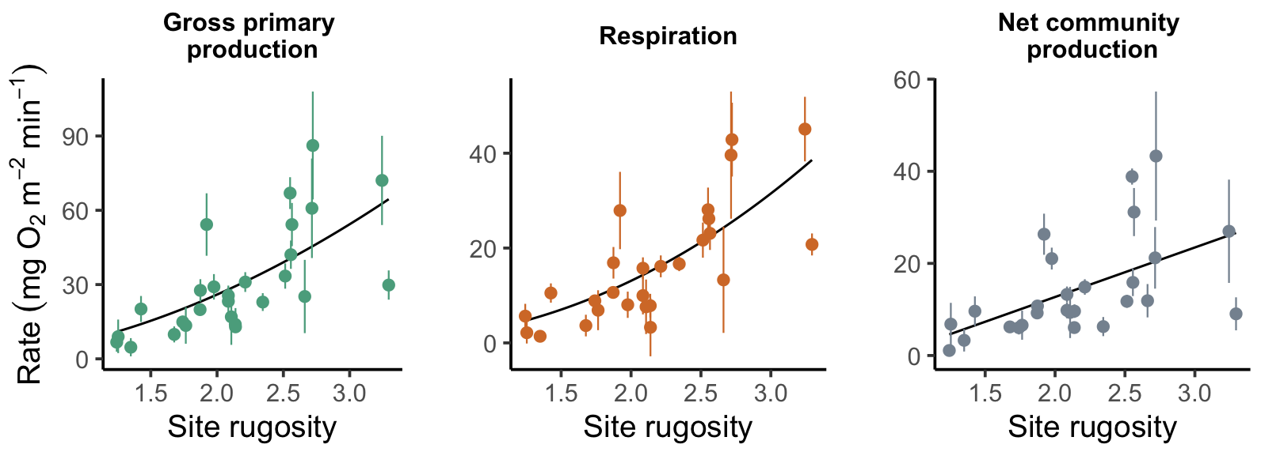
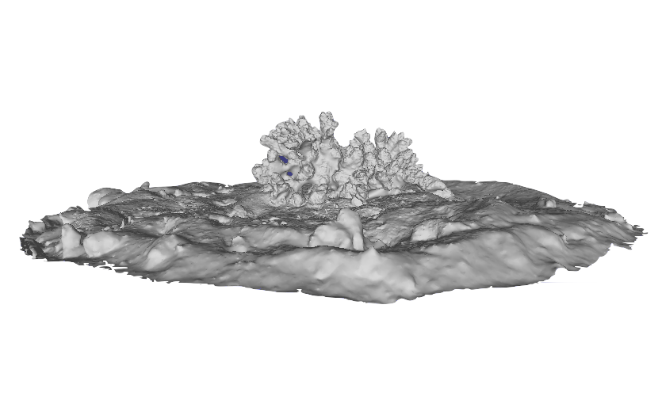
A
B
1
2
3
2
1
3
C
1
2
3

Slide 5
A
B
1
2
3
2
1
3
C
1
2
3

